Slide 1
Lecture 4: Why Tech Dev?
Michael MacCoss
maccoss@uw.edu
Notes:
How are technology and science similar? How are they different?

Slide 2
How are Technology and Science Different?
Purpose:
Methods:
Success criteria:
Timeline:
Direction:

Slide 3
How are Technology and Science Different?
Purpose: Science aims to discover and understand natural phenomena and build explanatory models of reality. Technology applies this knowledge to create tools, products, and systems that serve human needs.
Methods: Science follows the scientific method—forming hypotheses, testing through experiments, and refining theories. Technology focuses on design, engineering, and implementation to create solutions.
Success criteria: Scientific success means increasing our knowledge and creating better explanatory models. Technological success is measured by functionality, efficiency, usability, and market adoption.
Timeline: Science can pursue knowledge regardless of immediate applications. Technology typically aims for more immediate practical outcomes.
Direction: Science is primarily discovery-driven (understanding what exists), while technology is creation-driven (building what doesn't yet exist).

Slide 4
How are Technology and Science Similar?
Both pursue knowledge and understanding about the world
Both use systematic approaches to solve problems
Both build upon previous discoveries and innovations
Both require creativity and critical thinking
Both have transformative effects on society

Slide 5
Technology uses science to solve problems, and science uses technology to make new discoveries. However, technology and science have different goals. The goal of science is to answer questions and increase knowledge. The goal of technology is to find solutions to practical problems.

Slide 6
Telescope
Hans Lippershey invented the telescope in early 1600s. Galileo improved on the design
Galileo’s telescope changed what we could see
Observed craters on the moon
Discovered Jupiter had moons and Saturn had rings
Sun was at the center of the solar system
Relied on science
Lippershey and Galileo used knowledge of light and lenses
Each telescope design refined on the scientific knowledge gained from prior technology development
Microscope had a similar effect
Notes:
Does Technology Development make use of testable ideas?

Slide 7
Technology Development Uses Testable Ideas
Antenna was developed to test hypotheses about how electricity and magnetism work.
If the antenna had worked differently, it would have prompted a re-examination of that basic knowledge
Failures lead to new ideas and new technology developments.
Example: Hubble telescope originally had a mirror that had the wrong curve.
New technology inspires ongoing research and improves the technology

Slide 8
New directions in science are launched by new tools much more often than by new concepts.
The effect of a concept-driven revolution is to explain old things in new ways.
The effect of a tool-driven revolution is to discover new things that have to be explained.
Freeman J. Dyson

Slide 9
The last 40 years have seen a revolution in analytical instrumentation
Examples:
4 color sequencer (Lee Hood, Lloyd Smith, Mike Hunkapillar, Tim Hunkapiller) – 1986
Electrospray ionization MS (John Fenn, Nobel Prize) – 1984
Overcoming the diffraction limit in fluorescence microscopy (Betzig, Hall, and Moerner, Nobel Prize) – ~2000
Protein Structure Determination by NMR (Kurt Wuthrich, Nobel Prize) – ~1995
Cryo-Electron Microscopy (Alasdair McDowall and Jacques Dubochet) – 1985
Massively parallel sequencing (aka NGS) (Church, Mitra, Shendure, etc..) – 2005
What tools have shaped your research? How have they changed in the last decade?

Slide 10
What needs to be measured?

Slide 11
What needs to be measured?
Who – Need methods that can determine the identity of molecules in a mixture
What – Assess function and Role
Where – Localization
Intracellular
Intercellular
When – At all points and time and under different perturbations
With Whom – Determine interactions between molecules
How much – Assess quantities
Stability – Production and Disposal

Slide 12
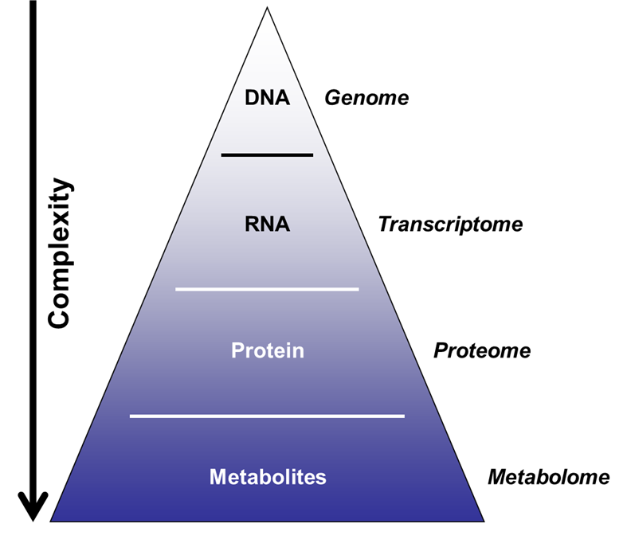
Major Biological Macromolecules Classes
Nucleic acids
DNA and RNA
Storage and transfer of genetic information
Proteins
Enzymes, hormones, antibodies, catalysts, structure, transport, motor, toxins
Carbohydrates
Energy source, structural, signaling
Lipids
Energy, compartmentalization, signaling

Slide 13
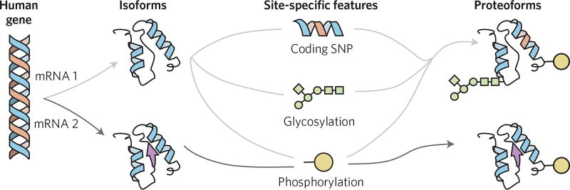
Proteins are complicated by PTMs
Aebersold et al, Nat Chem Biol, 2018

Slide 14
Spatial Heterogeneity
Outcome/result
Tissue sample
Bulk measurement

Slide 15
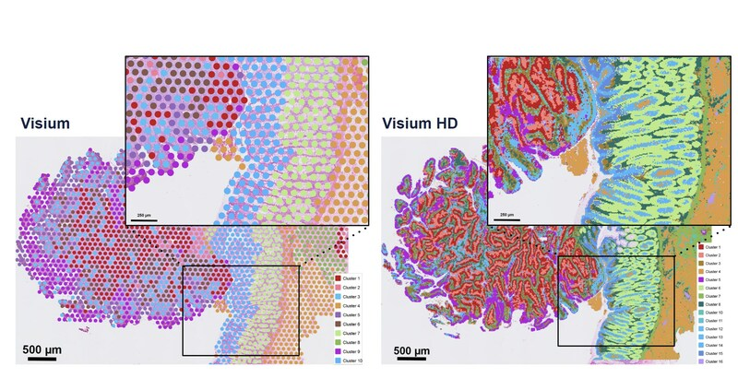
5,000 measurements at 50 µm resolution
11 million measurements at 2 µm resolution

Slide 16
Experimental limitations remain a challenge for spatial and low input proteomics
Spatial approach
Spatial samples are only a small fraction of the bulk aggregate samples
Tissue sample
Input
material
Throughput
Sensitivity
4

Slide 17
Single cell measurements can provide insights into cellular heterogeneity but loses spatial information
Single cell approach
Outcome/result
Single cell measurement
Tissue sample
vs
Aggregate Bulk
3

Slide 18
Localization can complicate quantitation

Slide 19
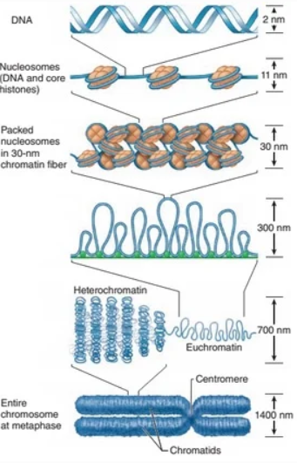
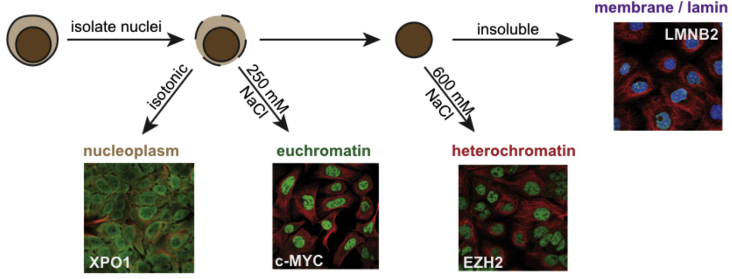
Chromatin biochemistry makes localization a problem
Notes:
Euchromatin:
Loosely packed, less condensed form of chromatin
Genetically active and accessible to transcription machinery
Contains most actively transcribed genes
Typically found in the inner regions of the nucleus
Stains lightly with basic dyes due to its open structure
Replicates earlier during S phase of the cell cycle
Rich in gene-dense regions and associated with active histone modifications (like H3K4me3 and acetylation marks)
Heterochromatin:
Tightly packed, highly condensed form of chromatin
Genetically inactive or has reduced transcriptional activity
Contains fewer genes and more repetitive DNA sequences
Often located near the nuclear periphery or nucleolus
Stains darkly with basic dyes due to its condensed nature
Replicates later during S phase of the cell cycle
Associated with repressive histone modifications (like H3K9me3 and H3K27me3)

Slide 20
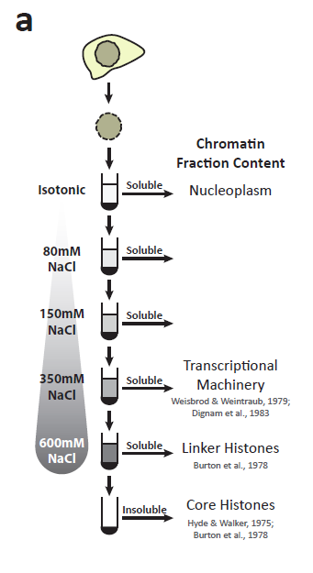
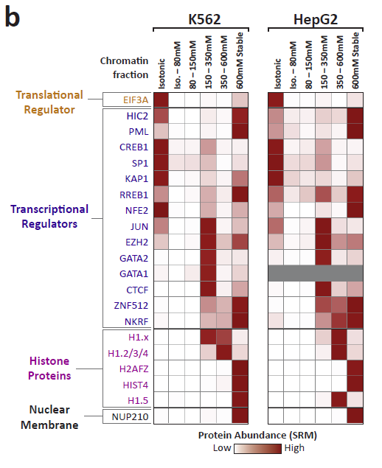
Segregation of transcription factors into discrete chromatin compartments
Data Andrew Stergachis

Slide 21
Is this a reasonable model?

Slide 22
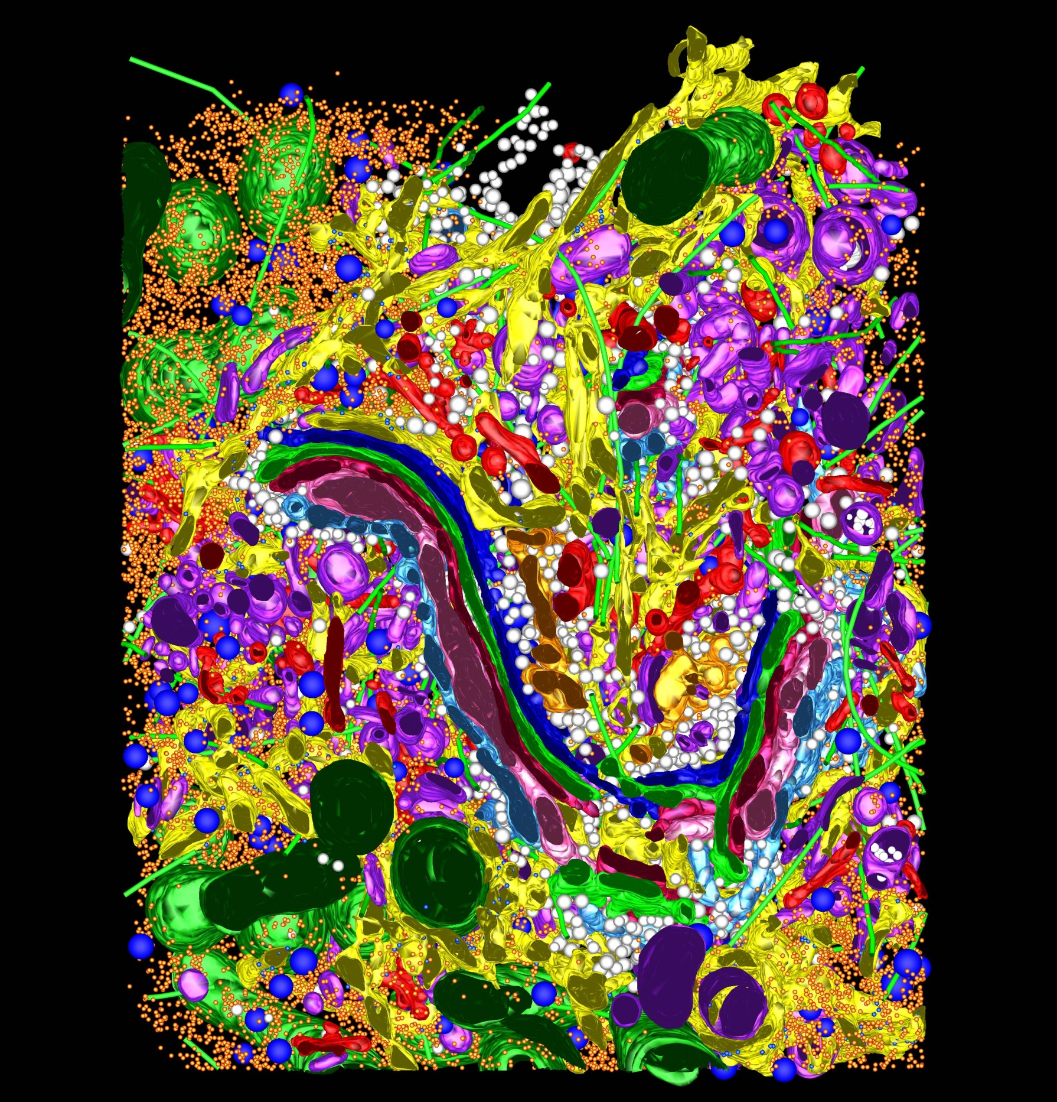

Slide 23
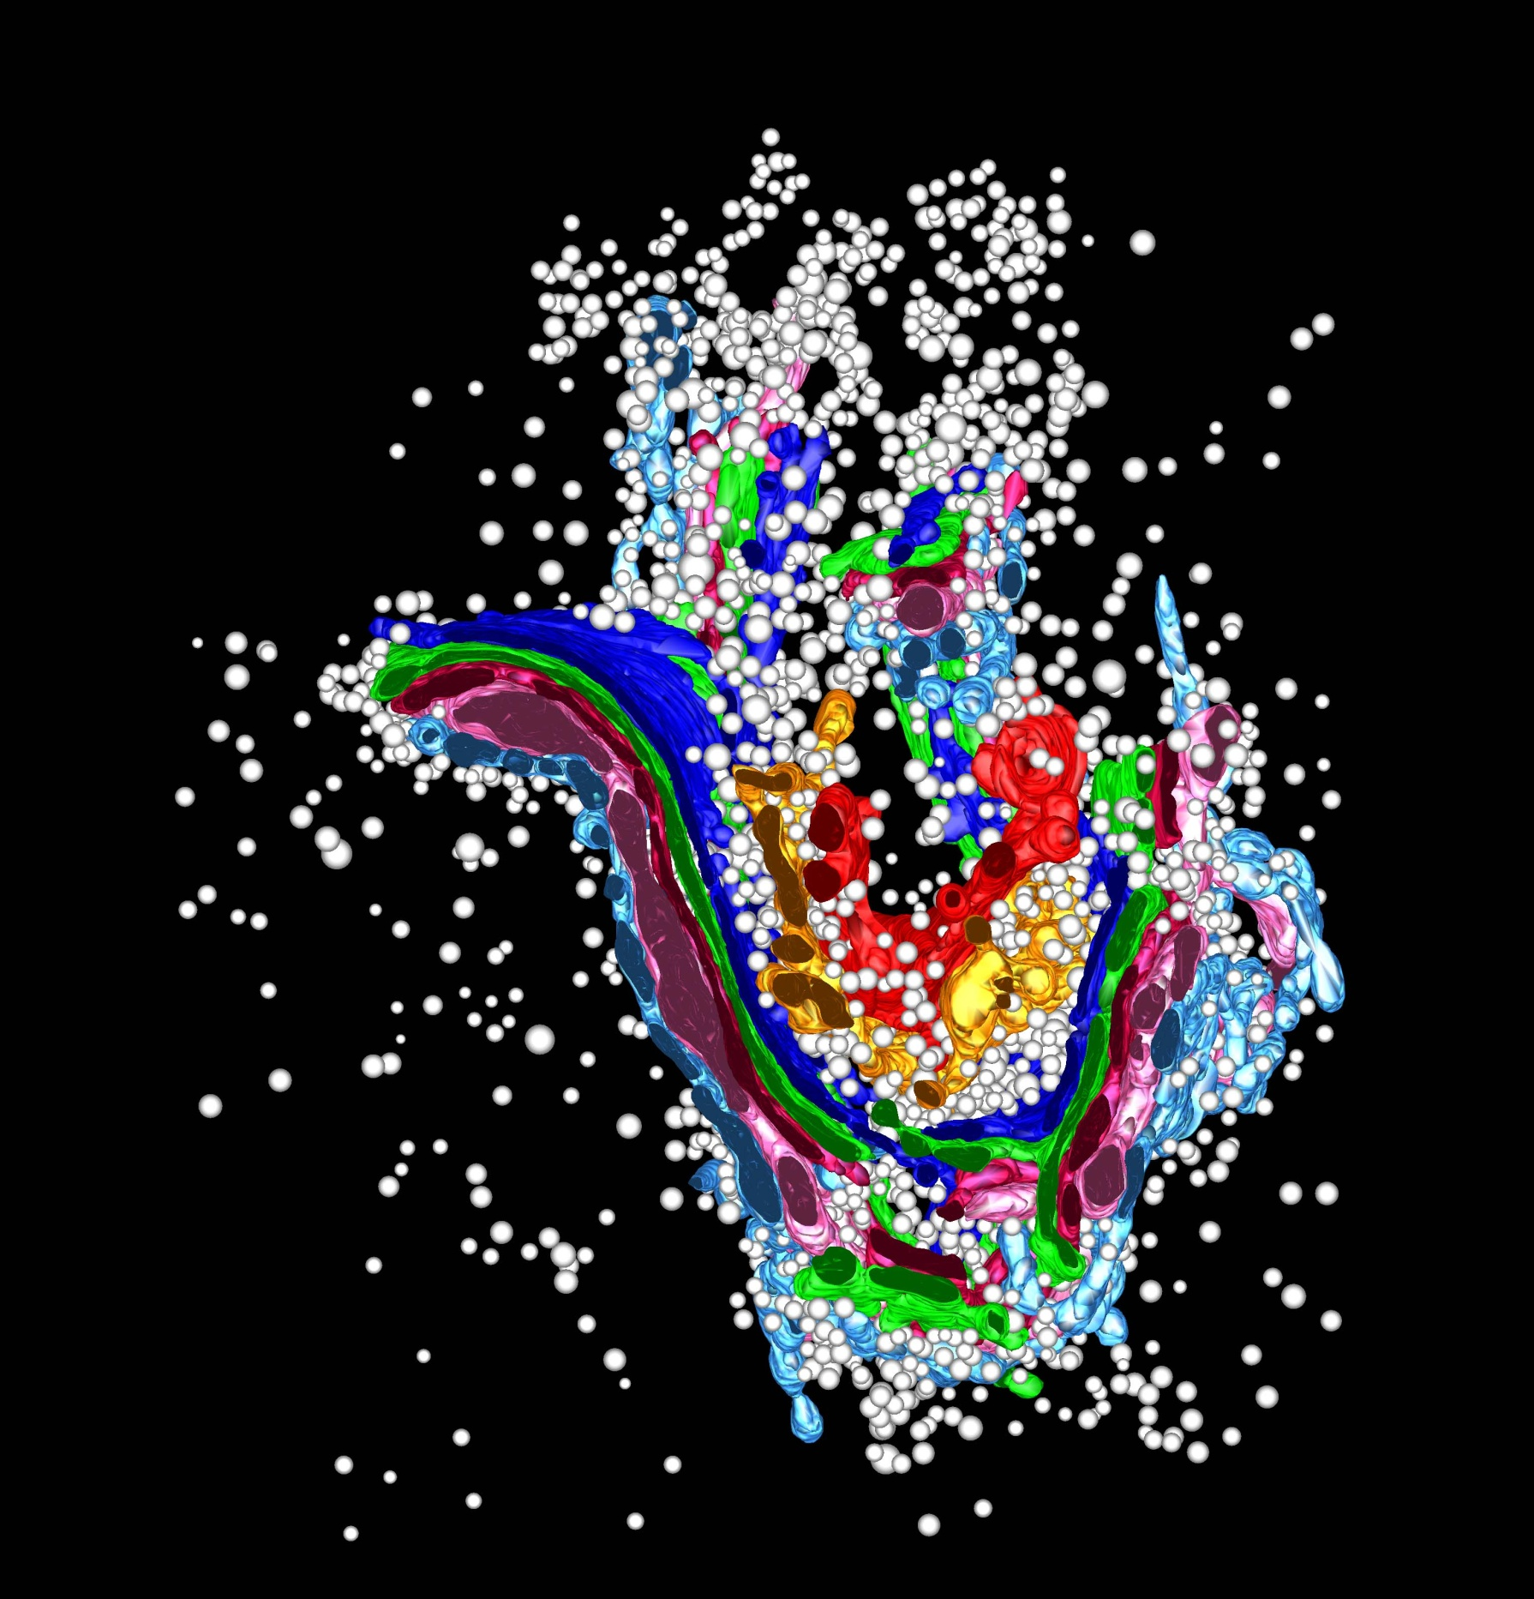

Slide 24
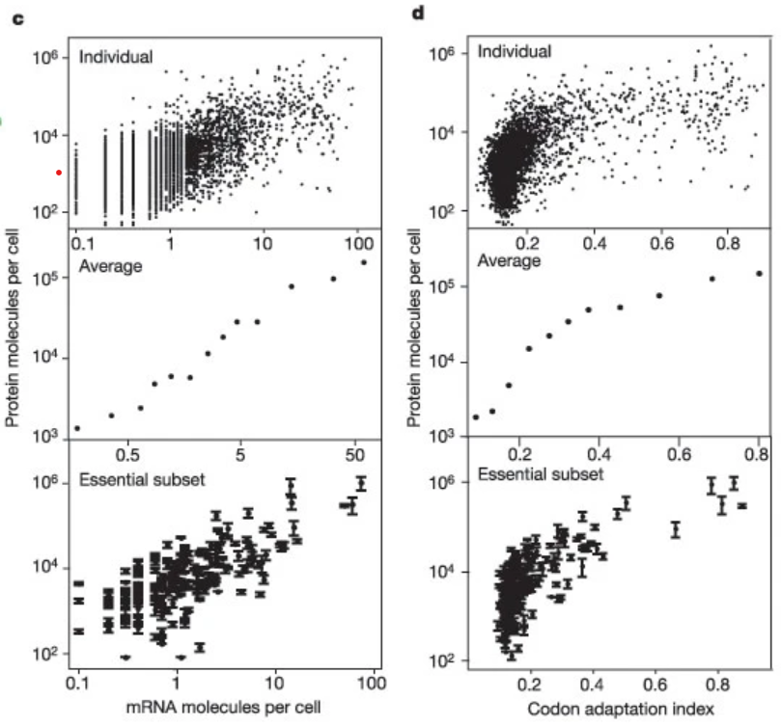
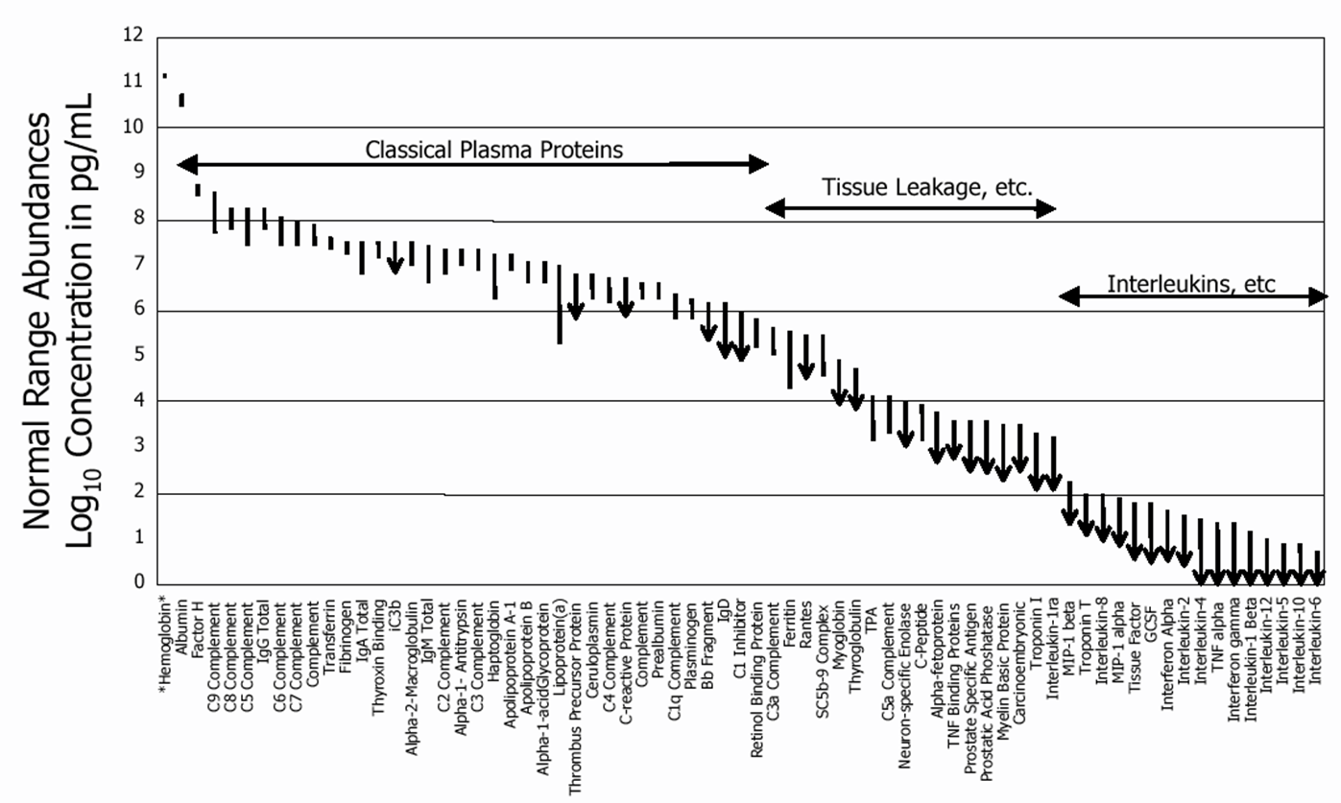
Dynamic Range
21 Proteins Represent 99% of the Blood Protein Mass
The proteome spans a dynamic range of 10^6 to 10^12
Ghaemmaghami et al, Nature 2003
Anderson and Anderson, Molecular and Cellular Proteomics 2002

Slide 25
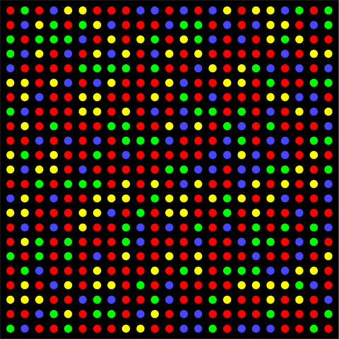
Lots and Lots of Molecules
400,000 mRNA molecules per cell = 40 million reads
Average transcript at ~5-10 copies
10,000,000,000 protein molecules per cell = 1 trillion reads
Average protein at 10⁴ to 10⁵ copies
Fluorescent wavelength = 200 – 750 nm
Leads to a practical density of ~1 µm
1 million reads: 1 mm²
100 million reads: 1 cm²
10 billion reads: 10 cm²
1 trillion reads: 1 m²
Scaling in Powers of 10 is Hard

Slide 26
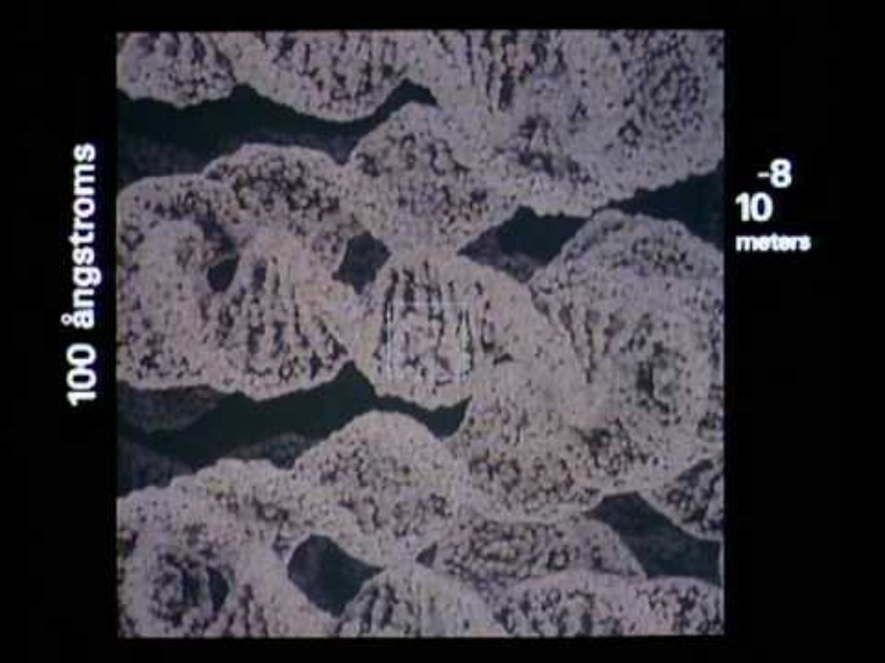

Slide 27
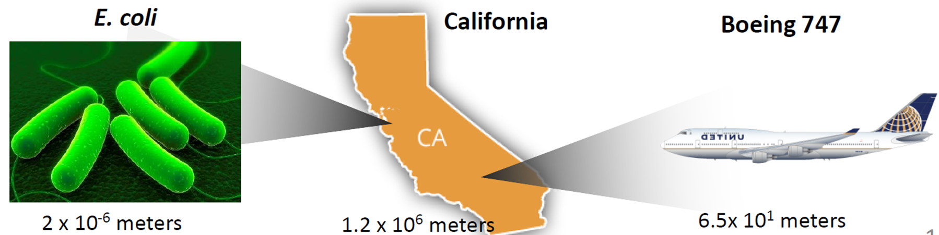
Where we need to be
Where we are at
If the most abundant protein represents the length of California, the least abundant proteins represent the length of E. coli. Most analytical methods only have 10⁴ to 10⁵ dynamic range. Representing the size of a 747.
Where we need to be to characterize the transcriptome: 4x10⁴ meters, ~marathon

Slide 28
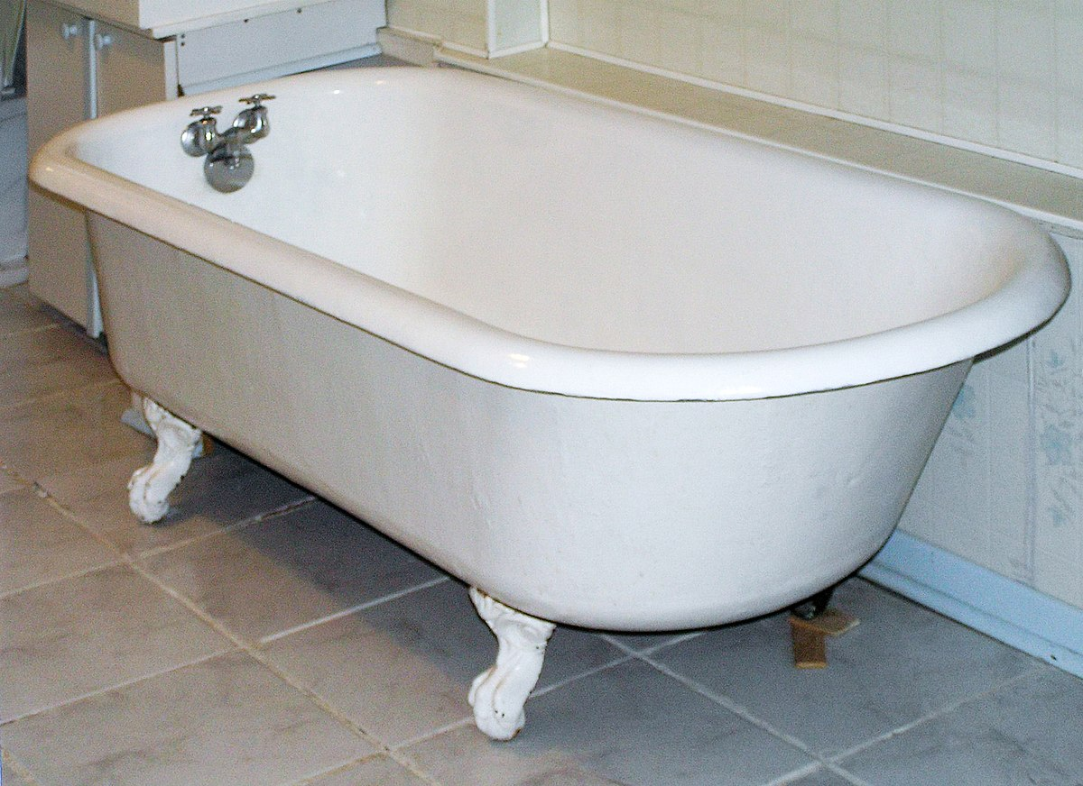
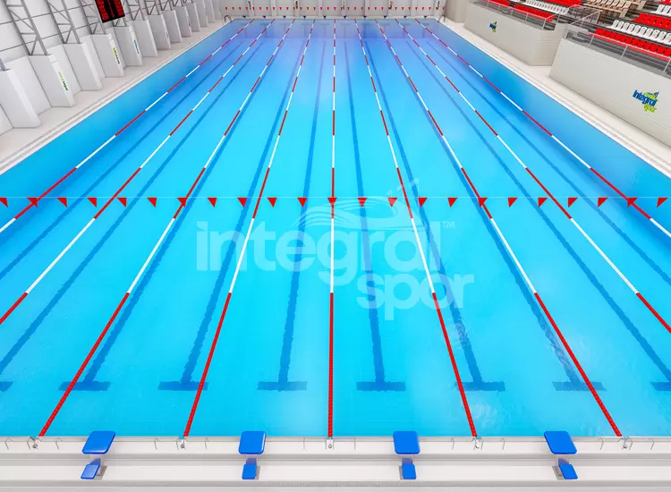
Measuring the volume of a swimming pool
80-100 liters (transcriptome)
2.5 million liters (proteome)

